Slide 1


Core Java

Slide 2


Today's session covers....?
1
What is Java?
Java Concepts
2
OOPs concept
3
Collections
4

Slide 3

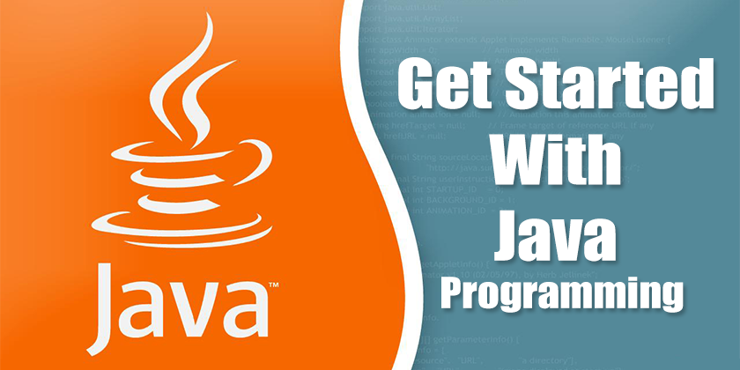


Slide 4

What is Java?​
JAVA was developed by Sun Microsystems Inc in 1991, later acquired by Oracle Corporation. It was developed by James Gosling and Patrick Naughton.
It is a simple programming language.
Writing, compiling and debugging a program is easy in java.
It helps to create modular programs and reusable code.
Features of Java:
Java is a platform independent language
Java is an Object oriented language
Simple & Robust Language
Secure & Portable
Multithreading

Slide 5
Java Concepts:
Datatypes in Java: There are two types of data types in Java -
Primitive data types: The primitive data types include boolean, char, byte, short, int, long, float and double.
Non-primitive data types: The non-primitive data types include Classes, Interfaces, and Arrays.
Variable declaration: To declare (create) a variable, you will specify the type, leave at least one space, then the name for the variable and end the line with a semicolon (;).
Syntax: type name;
Various access specifiers: The access specifiers are listed according to their restrictiveness order.
1) private (accessible within the class where defined) 2) default or package private (when no access specifier is specified) 3) protected 4) public (accessible from any class)
String and String Buffer & String builder: The String class is an immutable class whereas StringBuffer and StringBuilder classes are mutable. StringBuffer is synchronized i.e. thread safe. It means two threads can't call the methods of StringBuffer simultaneously.StringBuilder is non-synchronized i.e. not thread safe. It means two threads can call the methods of StringBuilder simultaneously.

Slide 6
Java Concepts:
Constructors and Methods:
Constructors:
Constructors are used to initialize the object’s state. Like methods, a constructor also contains collection of statements(i.e. instructions) that are executed at time of Object creation. Each time an object is created using new() keyword at least one constructor (it could be default constructor) is invoked to assign initial values to the data members of the same class.
Methods:
A method is a collection of statements that perform some specific task and return the result to the caller. A method can perform some specific task without returning anything. Methods allow us to reuse the code without retyping the code. In Java, every method must be part of some class which is different from languages like C, C++, and Python.
Super Keyword & this keyword:
The this keyword is used to access or call current class members(variables or methods or constructors). This keyword is required when we have parameters that have the same names as for instance variables or fields.
The super keyword is used to access or call parent class members(variables or methods).

Slide 7
Java Concepts:
Method Overloading and Overriding:
Overloading occurs when two or more methods in one class have the same method name but different parameters.
Overriding occurs when two methods have the same method name and parameters. One of the methods is in the parent class, and the other is in the child class. Overriding allows a child class to provide the specific implementation of a method that is already present in its parent class.
Garbage Collection: Java programs compile to bytecode that can be run on a Java Virtual Machine, or JVM for short. When Java programs run on the JVM, objects are created on the heap, which is a portion of memory dedicated to the program. Eventually, some objects will no longer be needed. The garbage collector finds these unused objects and deletes them to free up memory.

Slide 8
OOPs concepts
Abstraction is a process of hiding the implementation details and showing only functionality to the user.
Polymorphism is a concept by which we can perform a single action in different ways. Polymorphism is derived from 2 Greek words: poly and morphs. The word "poly" means many and "morphs" means forms. So, polymorphism means many forms.
There are two types of polymorphism in Java - compile-time polymorphism and runtime polymorphism. We can perform polymorphism in java by method overloading and method overriding.
Inheritance is a mechanism in which one object acquires all the properties and behaviors of a parent object.
Use of inheritance in java
For Method Overriding(so runtime polymorphism can be achieved).
For Code Reusability.
Encapsulation is defined as the wrapping up of data under a single unit. It is the mechanism that binds together code and the data it manipulates. Another way to think about encapsulation is, it is a protective shield that prevents the data from being accessed by the code outside this shield.

Slide 9
Collections

Slide 10
Java Collections
The Collection in Java is a framework that provides an architecture to store and manipulate the group of objects.
Java Collections can achieve all the operations that you perform on a data such as searching, sorting, insertion, manipulation, and deletion.
Example for different types of Interface in Java collections (Set, List, Queue, Deque) and classes (ArrayList, Vector, LinkedList, Priority Queue, HashSet,

Slide 11
List, Hash Map, Hash List
List: It is an ordered collection of objects in which duplicate values can be stored.
Hash Map: Map is an interface in the Java Collection Framework and a HashMap is one implementation of the Map interface. HashMap are efficient for locating a value based on a key and inserting and deleting values based on a key
Java HashSet class is used to create a collection that uses a hash table for storage. It inherits the AbstractSet class and implements Set interface. ... HashSet stores the elements by using a mechanism called hashing.

Slide 12
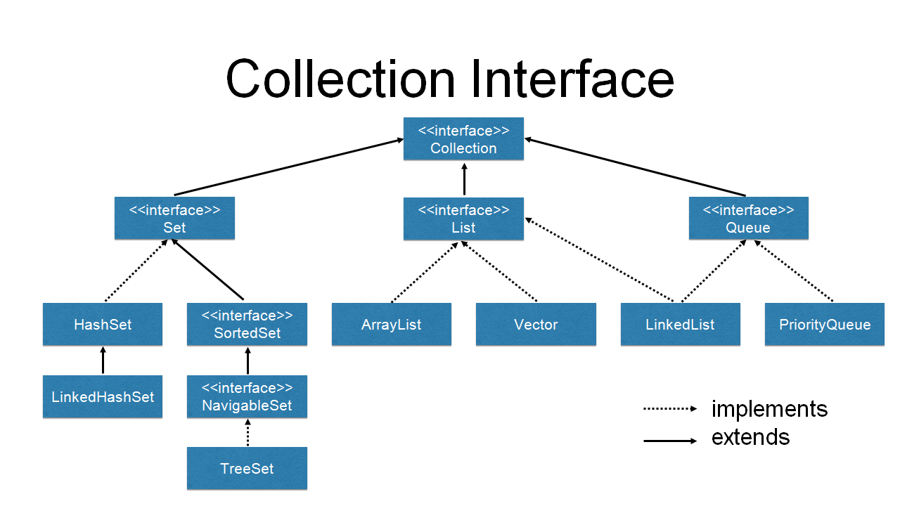

Slide 13
Exception-handling
In Java, an exception is an event that disrupts the normal flow of the program. It is an object which is thrown at runtime.
The Exception Handling in Java is one of the powerful mechanism to handle the runtime errors so that the normal flow of the application can be maintained. Exception Handling is a mechanism to handle runtime errors such as ClassNotFoundException, IOException, SQLException, RemoteException, etc.
Types of Java Exceptions:
1) Checked Exception
The classes that directly inherit the Throwable class except RuntimeException and Error are known as checked exceptions. For example, IOException, SQLException, etc. Checked exceptions are checked at compile-time.
2) Unchecked Exception
The classes that inherit the RuntimeException are known as unchecked exceptions. For example, ArithmeticException, NullPointerException, ArrayIndexOutOfBoundsException, etc. Unchecked exceptions are not checked at compile-time, but they are checked at runtime.
3) Error
Error is irrecoverable. Some example of errors are OutOfMemoryError, VirtualMachineError, AssertionError etc.

Slide 14
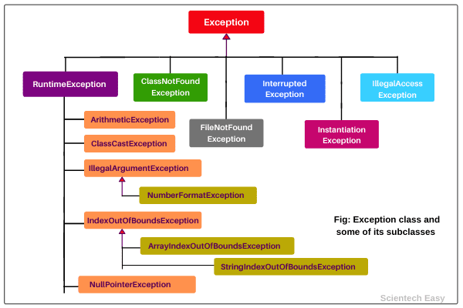

Slide 15
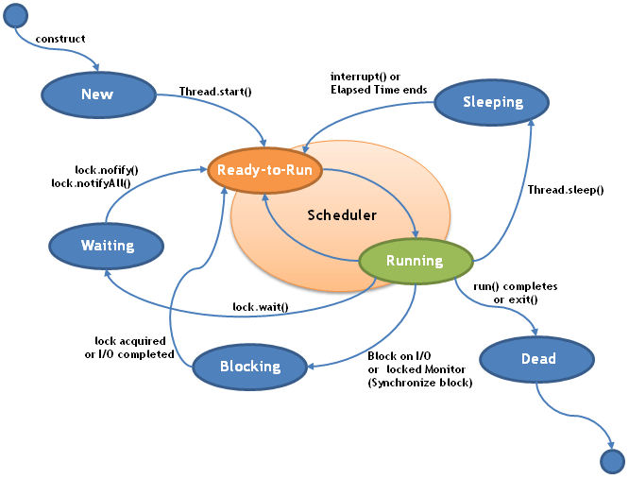
Thread life-cycle

Slide 16

Points to be Remember:
How to declare variables in Java ?
What are all the datatypes in java ?
What are the different types of operators present in Java ?
Various access specifiers
Exception-handling
Differences between the constructors and methods
Meaning of Super Keyword & this keyword
Difference between method Overloading and Overriding
Differences between String and String Buffer & String builder
What is Garbage Collection
Difference between final, finally and finalize
InputStream and OutputStream
lifecycle of a Thread
difference between notify() and notifyAll()

Slide 17
Thank you
Japan
c/o In Control,
ARK Hills Front Tower RoP 806,
2-23-1 Akasaka, Minato-ku,
Tokyo, Japan 107-0052,
United States
691, S Milpitas Blvd., Suite #217, Milpitas, CA, 95035
India
#221, 2nd Floor, 7th Main, 2nd Block,
HRBR Layout, Kalyan Nagar, Bengaluru, Karnataka, Pin-560043
China
Rm1306, Zhonghuang Bldg, No1007, 2nd South Zhongshan Rd, Shanghai, 200030, China
Phone
+1 651 204 2720
+91 80 4372 3204
+86 13381926699
E-Mail
info@ideapoke.com
sales@ideapoke.com

